Slide 1
Intro to Linear Algebra
Week 1 & 2
Quantum Masters:
Alex - Ashkan - Elena - Esther -Eva - Lucy

Slide 2
Purpose of Linear Algebra
It allows physicists to describe space and the manipulations of space through numbers
We use linear algebra to study quantum mechanics, the mathematical description of the movement of subatomic particles.

Slide 3
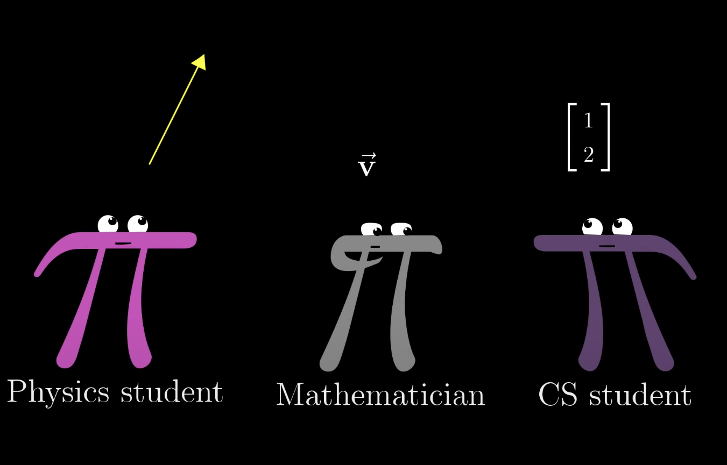
Vectors
- Elements of a set known as vector space.
- Mathematical quantity with both direction and magnitude.
· Physics perspective: Arrow with length and direction.
· Computer Science perspective: *tuple* list of numbers.
· There are three perspectives over vectors

Slide 4
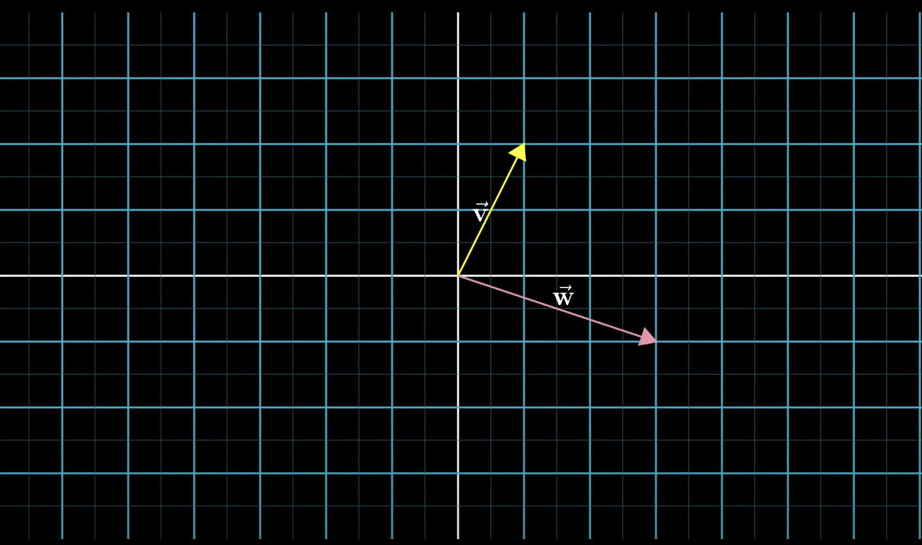
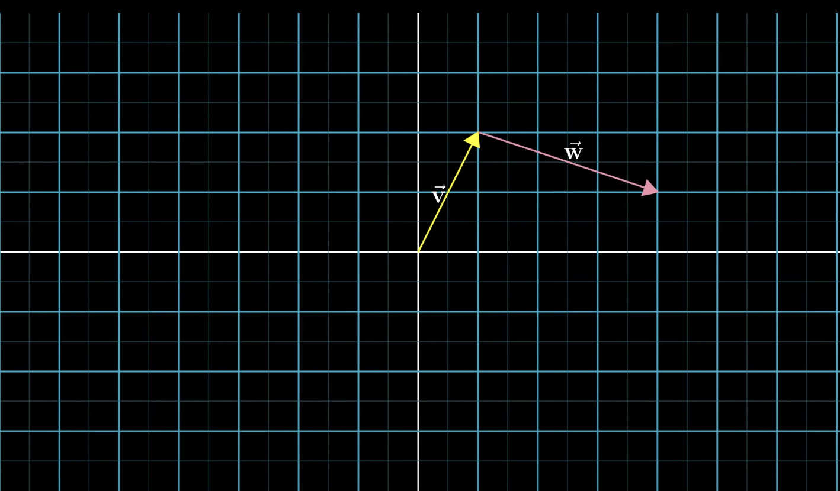
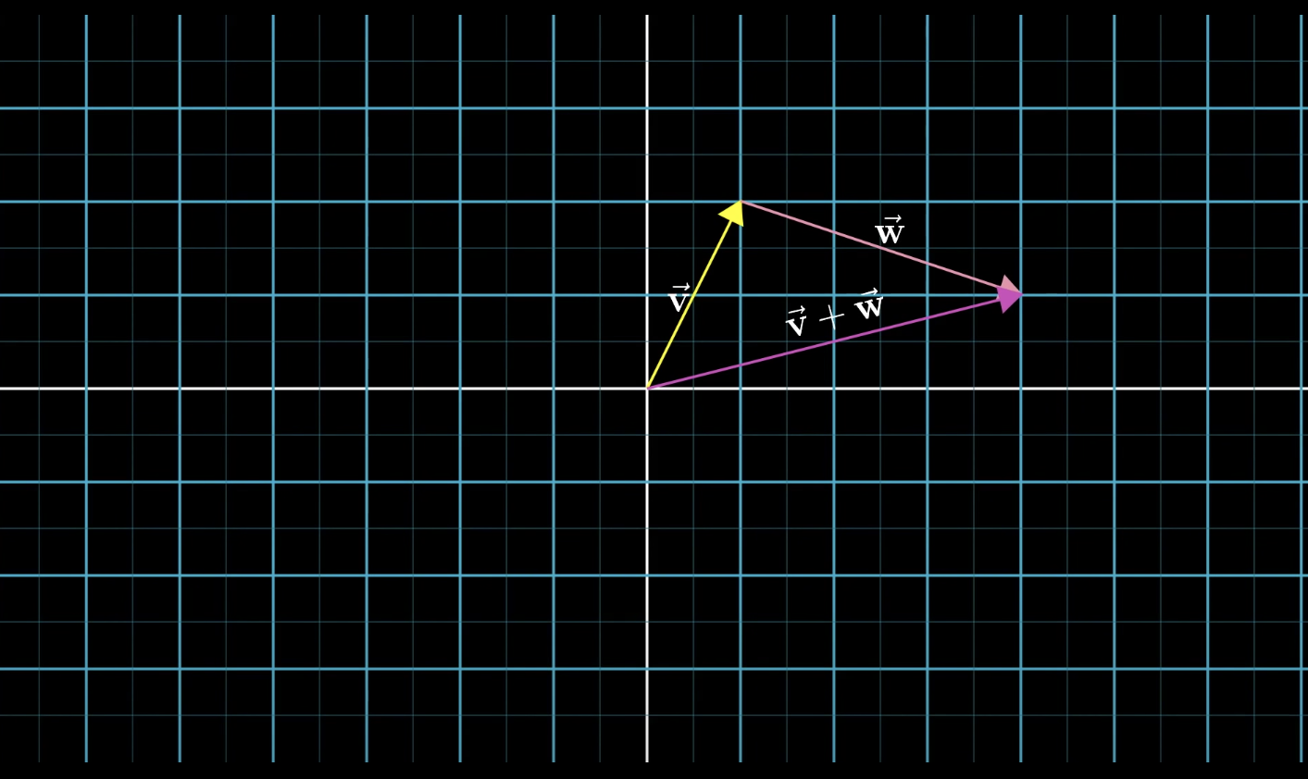
Vector Space: A vector space (V) over a field (F) is a set of objects (vectors), where two conditions hold:
Vector Addition-
- Put V₁’s tail at the tip of V₂. A straight line connecting the tail of V₂ to the tip of V₁ / or V₁ + V₂

Slide 5
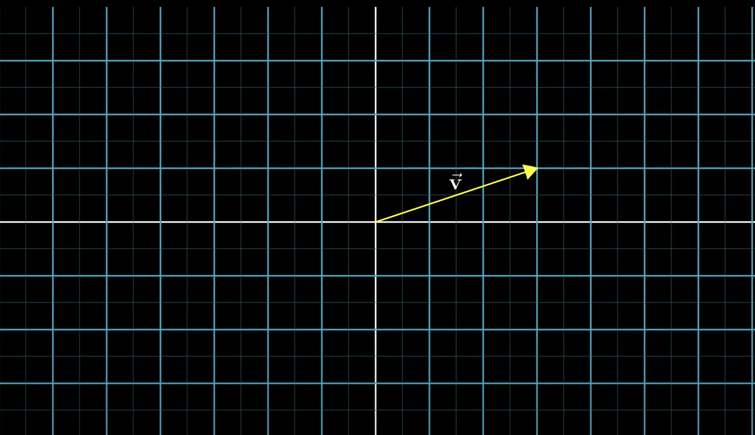
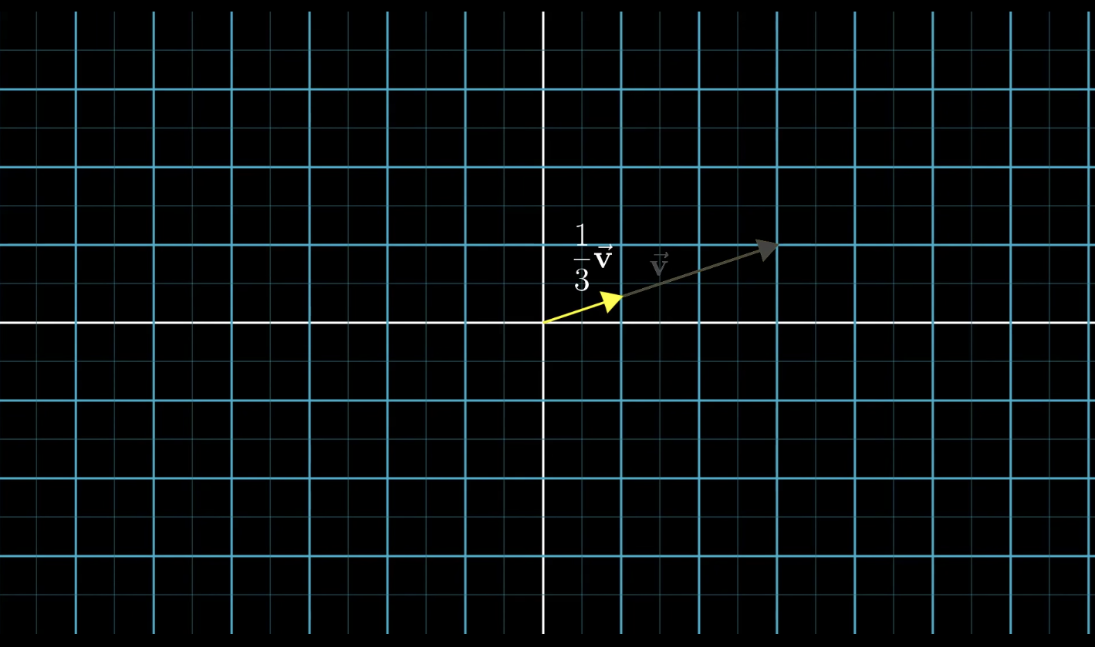
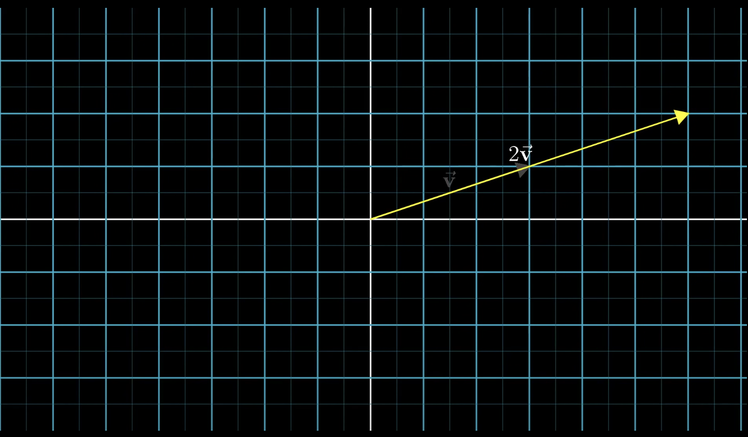
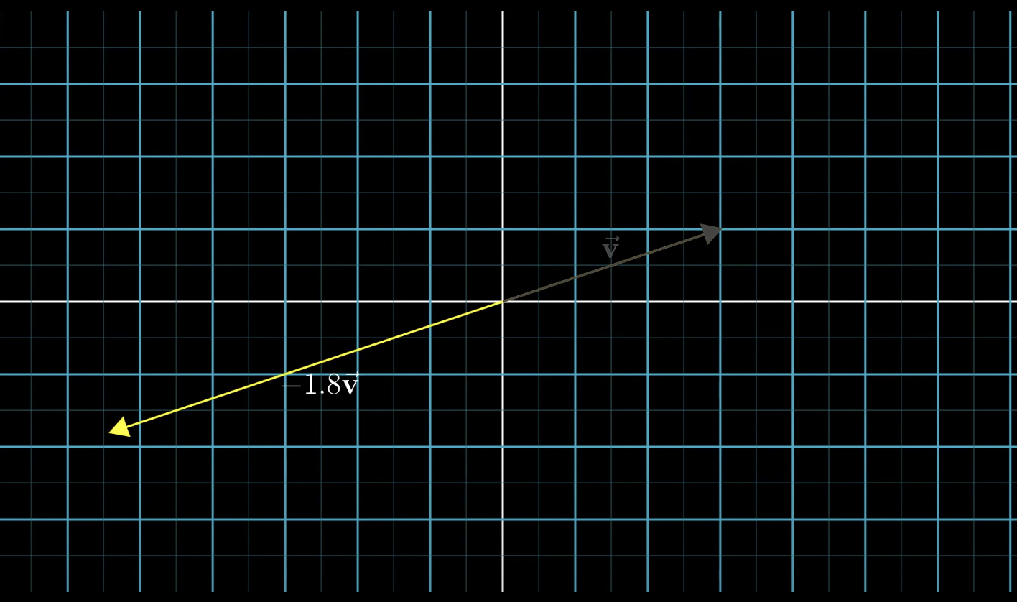
Scalar Multiplication
- V = (3, 1) | 1/3 V₁= (1, ⅓) | 2 V₂ = (6, 2) | -1.8 V₃ = (-5.4, -1.8)
- The numbers that scale the vector are called “Scalar” (1/3 & 2 & -1.8).

Slide 6
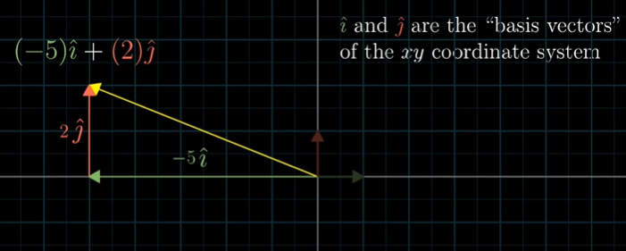
State Vectors: Vectors that point to a specific point in space that corresponds to a particular quantum state.
Basic Vectors:
- i & j: The basic vectors of 2-D space.
- i & j & k: The basic vectors of 3-D space.

Slide 7
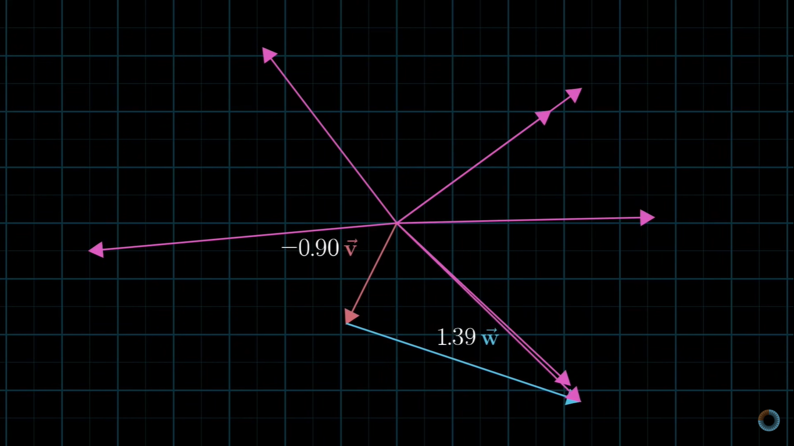
Span
The set of all of linear combinations
A linear combination of vectors is the sum of vectors multiplied by scalars
A set of vectors are called linearly independent if none of the vectors can be expressed as a linear combination of the others
In an n-dimensional vector space, the span of n linearly independent vectors is the whole vector space

Slide 8
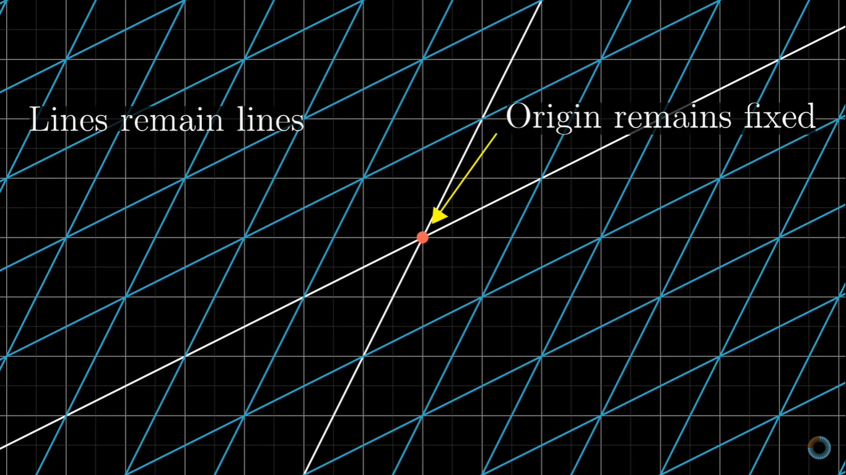
Linear Transformations
Used to move around space
“Transformation” = function
Takes in input, results in output
Two rules to be a linear transformation:
Lines remain lines (no curving)
Origins remains in same place
Grid lines stay parallel and evenly spaced
“Shear”: i remains fixed

Slide 9
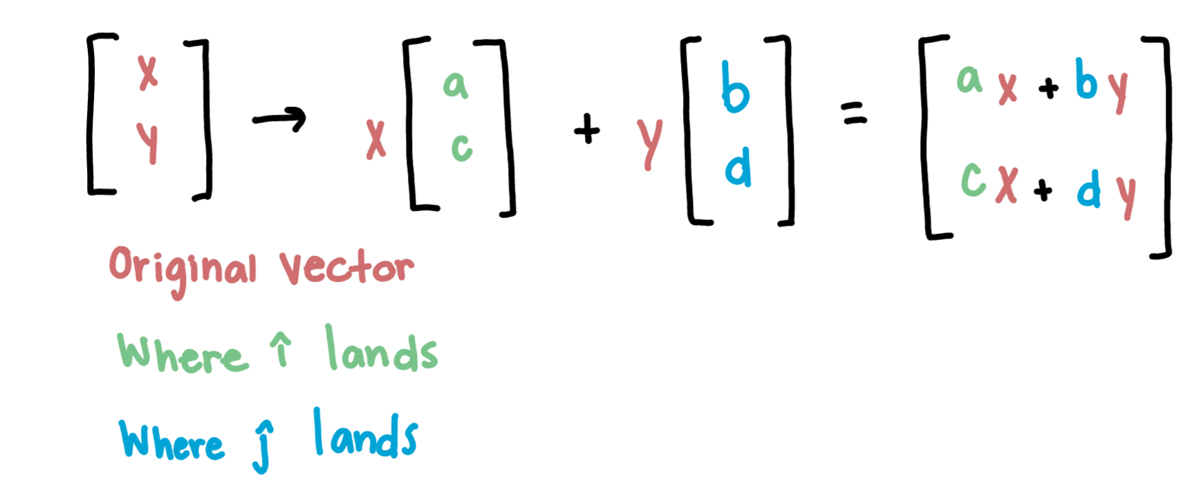
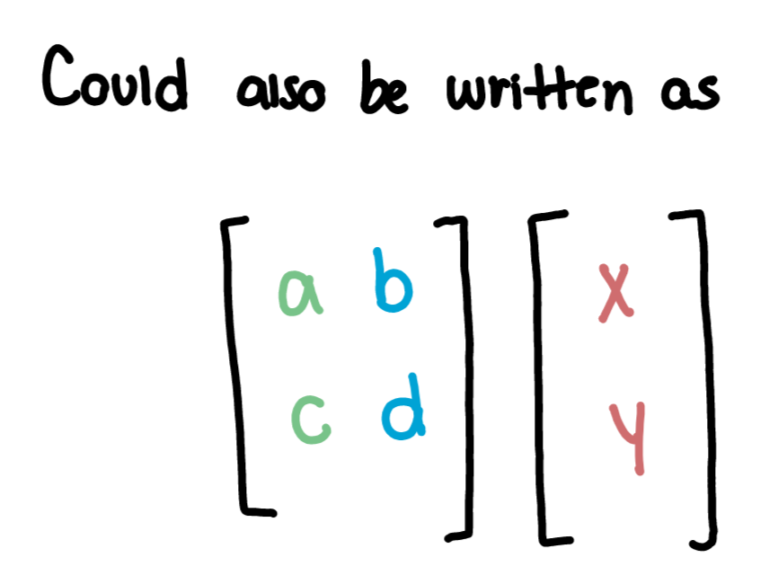
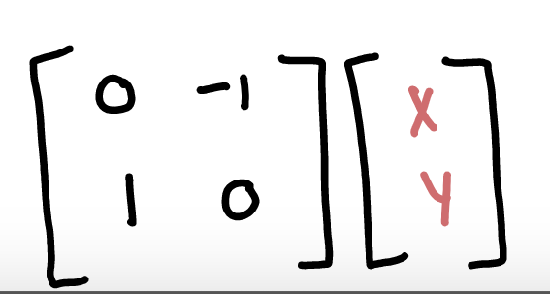
Linear Transformations
90° rotation:
Multiply vector by the new locations of i and j
Starting with a matrix to find transformation:
Move i to new location, and move j to new location
If linearly dependent, linear transformation reduces all of 2-D space onto line with two vectors
Notes:
This tells you where the linear transformation takes the vector

Slide 10
Matrix Multiplication as Composition
“Composition”: the combination of two different transformations (EX: Rotation then shear)
Record where i and j land, and new composition matrix captures the transformation as one single action, not two
The composition matrix is the product of the original two matrices (that are the transformations), read from right to left
^
^

Slide 11
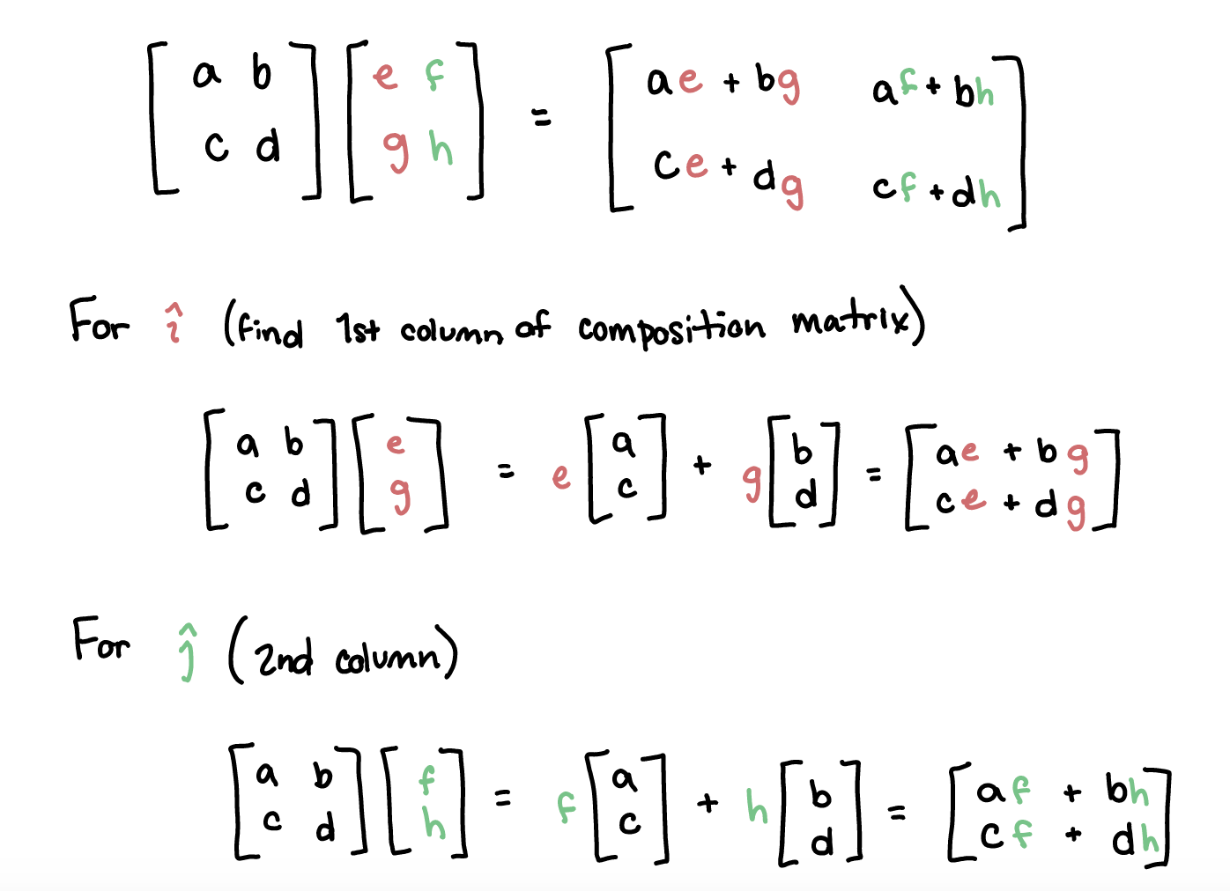
Matrix Multiplication as Composition

Slide 12
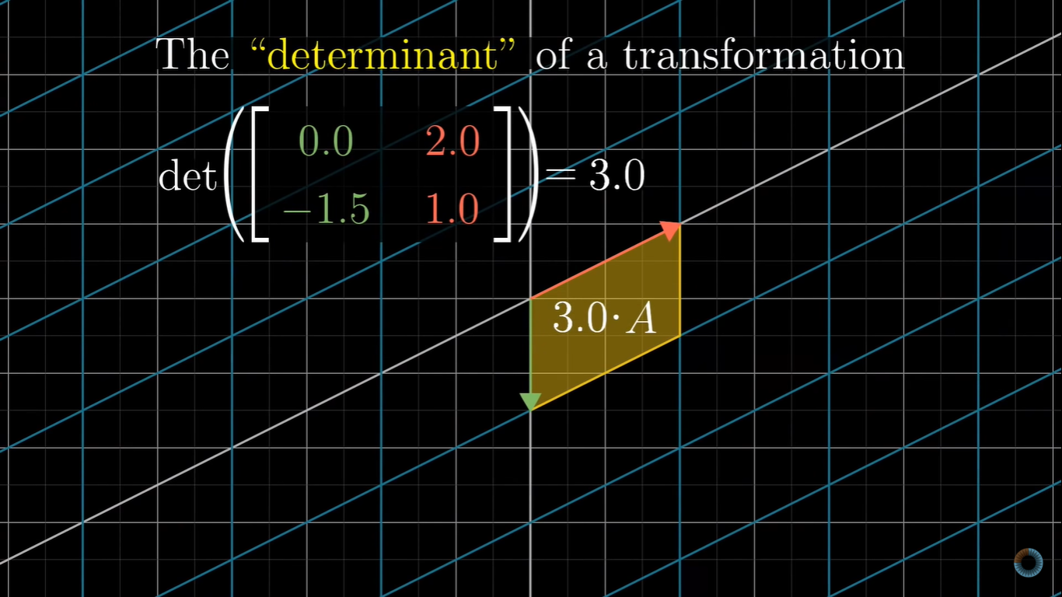
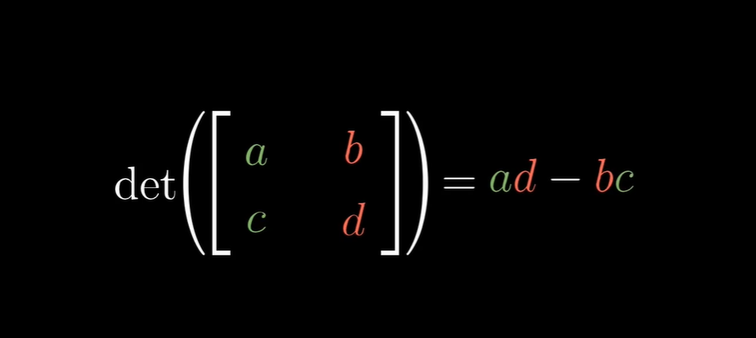
The Determinant
The Determinant is known as the scaling factor by which any linear transformation changes an area
Ask yourself: “How much does the area change by? What is the factor by which the area increases?
Notes:
The area is increased by a factor of 3 so the determinant of the transformation is 3

Slide 13
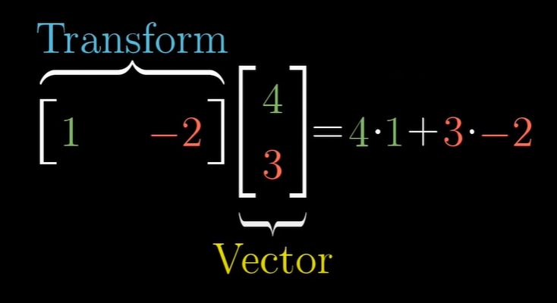
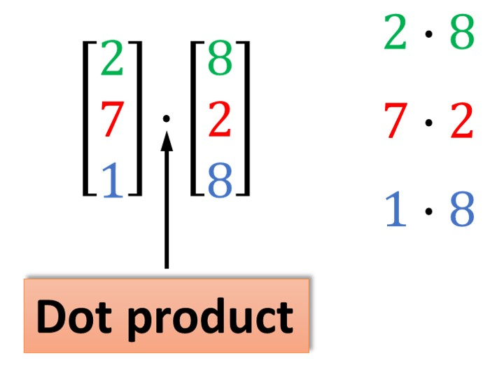
Dot Product
For any two vectors U = <a₁, a₂, … a_{n}> and V = <b₁,b₂ … b_{n}>, the dot product of U and V is defined as a₁b₁ + a₂b₂ + … + a_{n}b_{n}, and is notated as U·V
U·V = ❘U❘❘V❘(cos θ), where θ is the angle between the vectors U and V
By rewriting the above equation as ❘V❘ cos θ = (U·V)/❘U❘ or ❘U❘ cos θ = (U·V)/❘❘V❘, we can find the magnitude of the projection of V onto U or U onto V
You are pairing up all the coordinates and multiplying

Slide 14
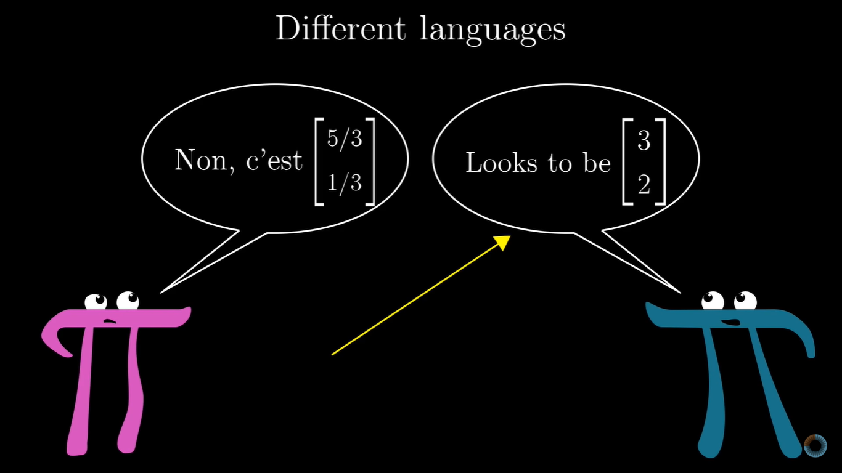
Change of Basis
We typically look at vectors in the standard square grid, a construct. But they can actually be looked at from different perspectives depending on the basis vectors. The origin is always the same though.
What’s important here is how to translate the different coordinates.

Slide 15
Eigenvector & Eigenvalues
- Eigenvectors: Non-zero vectors that remain on their span after a transformation.
- Eigenvalues: The factors by which the eigenvectors will get stretched or squashed during the transformation.
- Negative eigenvalue means that the eigenvector will get flipped.
- Axis of rotation: An eigenvalue for a 3-D rotation that will remain on its own span.

Slide 16
- Formula: A V = λ V
A (matrix), V (eigenvector), λ (lambda (is a number, the corresponding eigenvalue)), I (identity vector)
A V = λ A A V = (λI) V A V - (λΙ)V = 0 (A - (λI))V = 0
- Only possible when det (A - (λI)) = 0
- A 2-D transformation doesn’t have to have eigenvectors (e.g. rotation by 90°).
- It is possible to have one eigenvalue, but with more than just a line full of eigenvectors.
- Anytime a matrix has 0’s everywhere other than the diagonal, it’s called, reasonably enough, a diagonal matrix. The way to interpret this is that all basis vectors are eigenvectors, with diagonal entries of this matrix being their eigenvalues.
- A set of basis vectors, which are also eigenvectors are called an eigen basis.

Slide 17
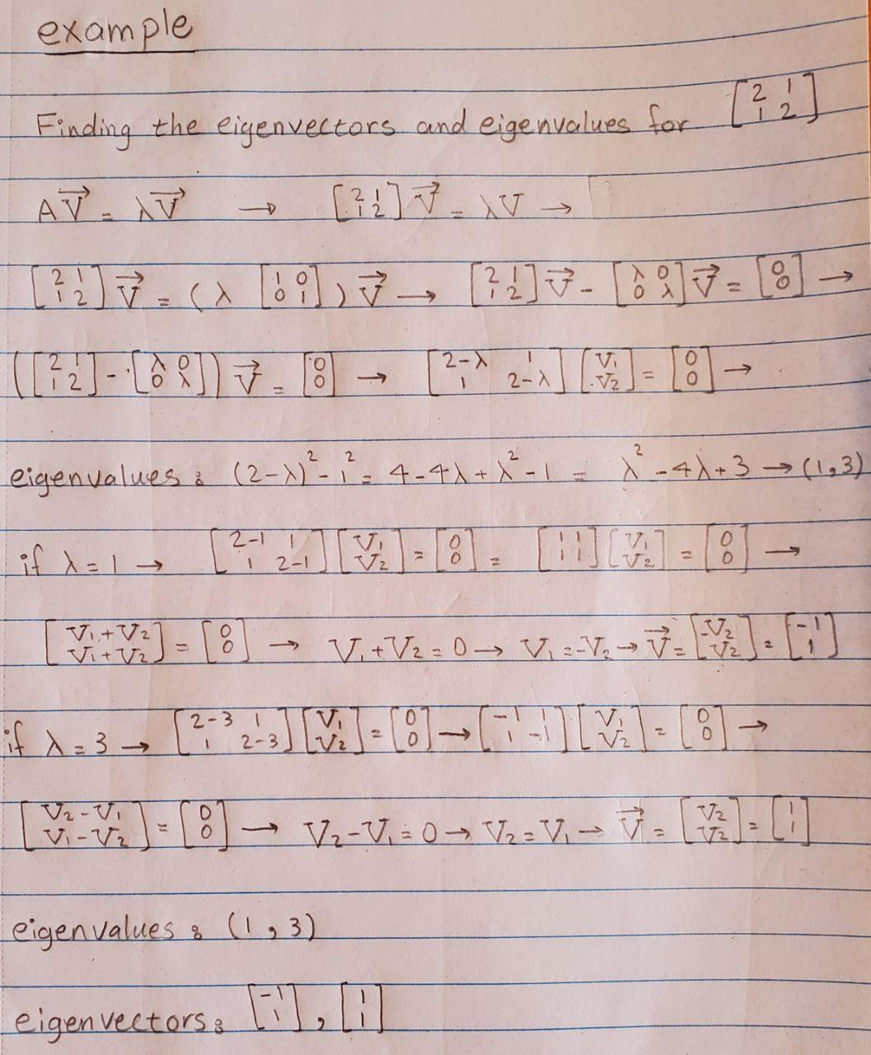
Here is an example of how to find eigenvectors and eigenvalues of a matrix

Slide 18
Quantum Information
Lucy, Eva

Slide 19
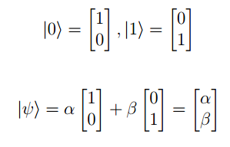
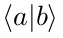
Dirac Notation (Bra-Ket)
Simplifies representation of state vectors
Bra notation for complex conjugate of ket
Nice inner product notation

Slide 20

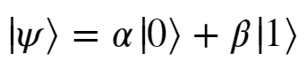
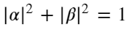
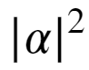
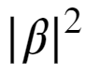
Properties of Qubits
For a single qubit, we define the computational basis (the results of our measurements) as
This means we can express some arbitrary state as (because we work in the Hilbert Space):
And we make sure these basis states are defined so that their inner product is 0 (AKA they are orthogonal - no overlap!)
We also want to impose that: since and represent the probabilities of measuring |0> and |1> respectively. (AKA the vector representing the qubit must have a length of one)

Slide 21
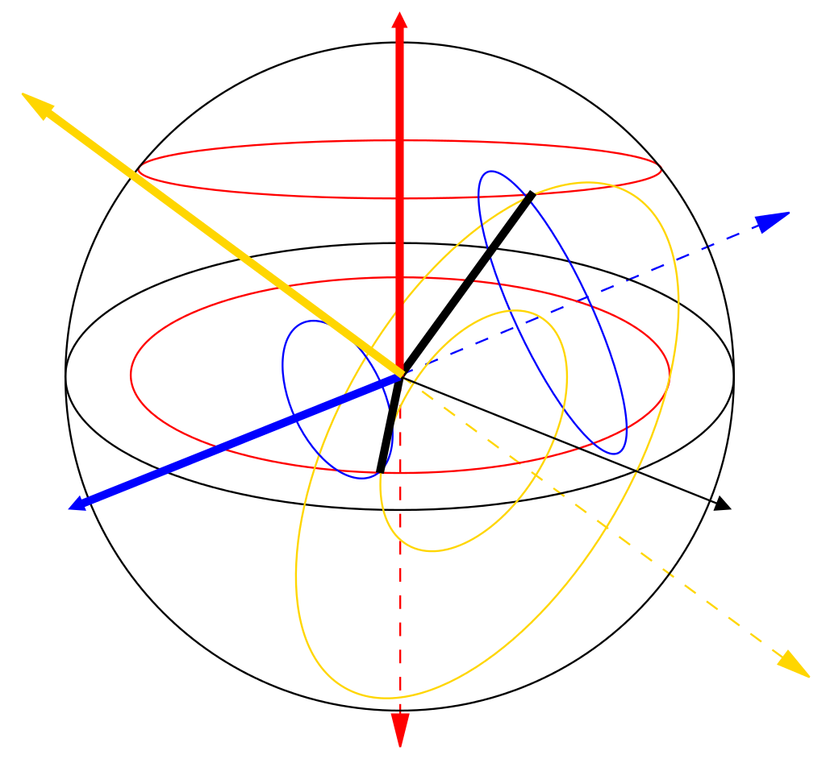

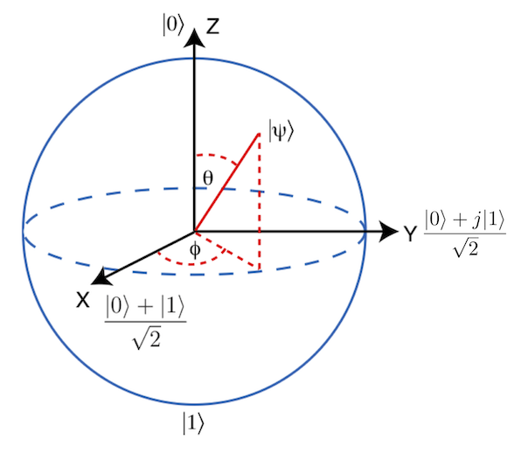
Geometric Representation
The Hilbert space is a complex vector space so 𝛼 and 𝛽 are complex numbers. Thus, our axes are |0> and |1> in C² which can be represented as a unit sphere in cartesian coordinates.
Even more simply, we can express our arbitrary state in terms of the two angular parameters 𝜃 and 𝜙:
Basis Vector:

Slide 22



Qubit Operations
In general, qubit operations are represented by unitary matrices:
The column space of U consists of orthonormal vectors:
Observables (quantities that can be measured) are Hermitian matrices.
Special kind of Unitary matrices that have real eigenvalues.

